Slide 1
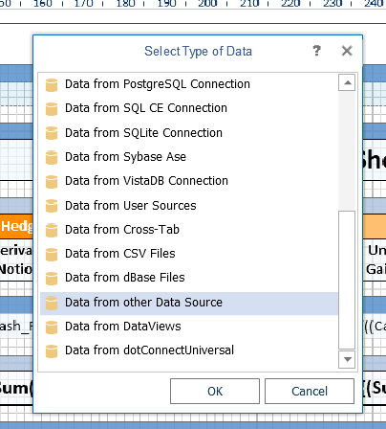
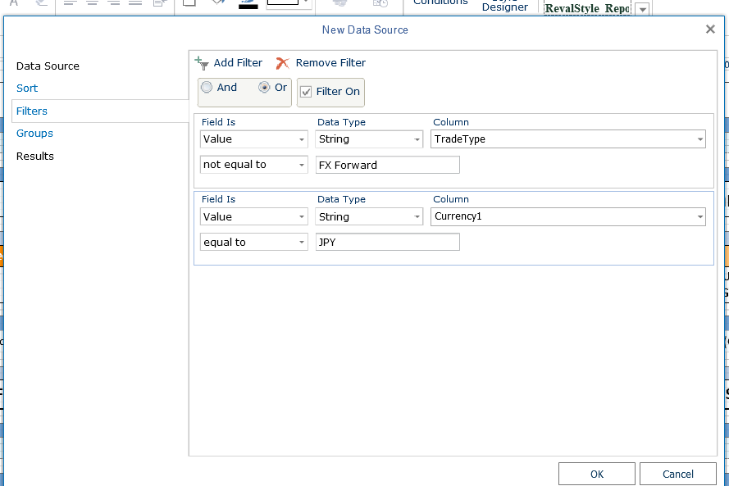
Create New Data Source by using Data from other Data Source
2. In Data Source enter filter with or as the filter.

Slide 2
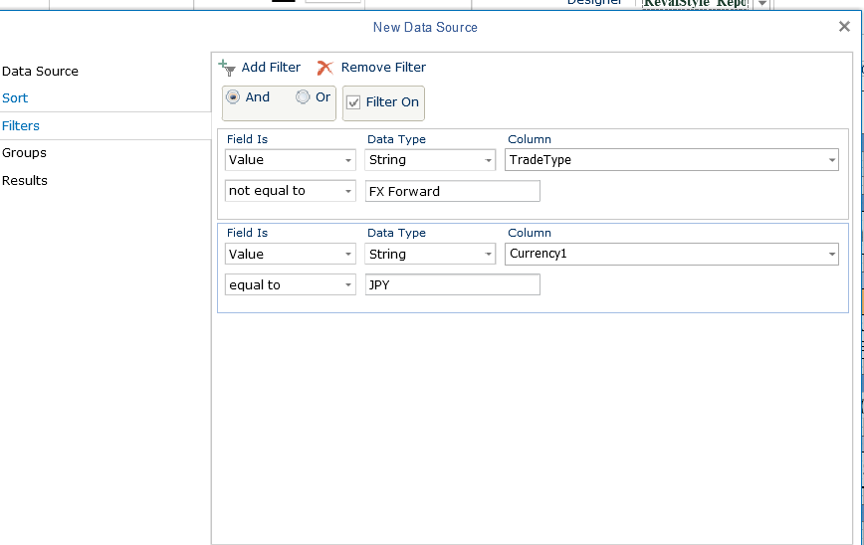
When I go back into the filter it changes back to and. I want to exclude anything that says FX Forward on trade type column as well as include JPY
On column. Basically include FX Option as the trade type but only for JPY currency

