Slide 1
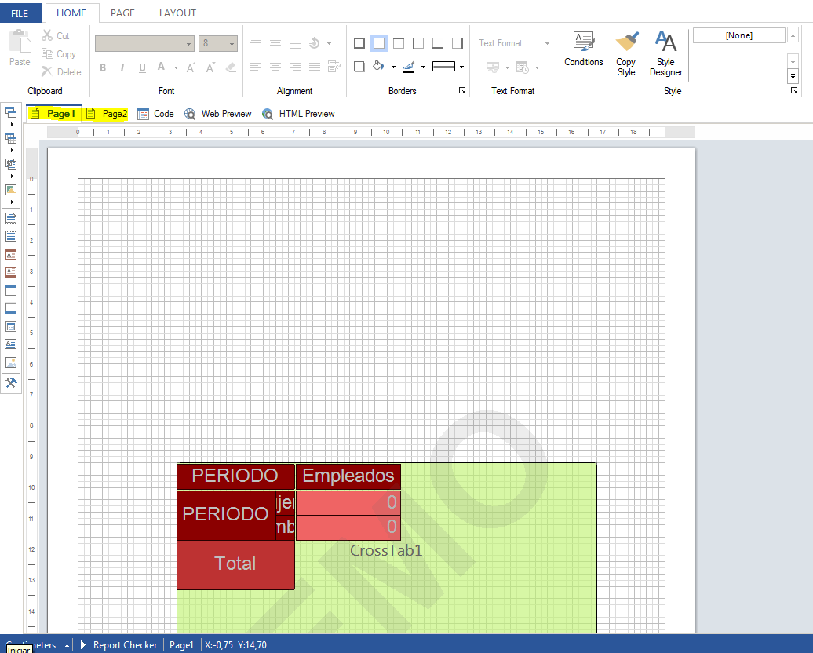
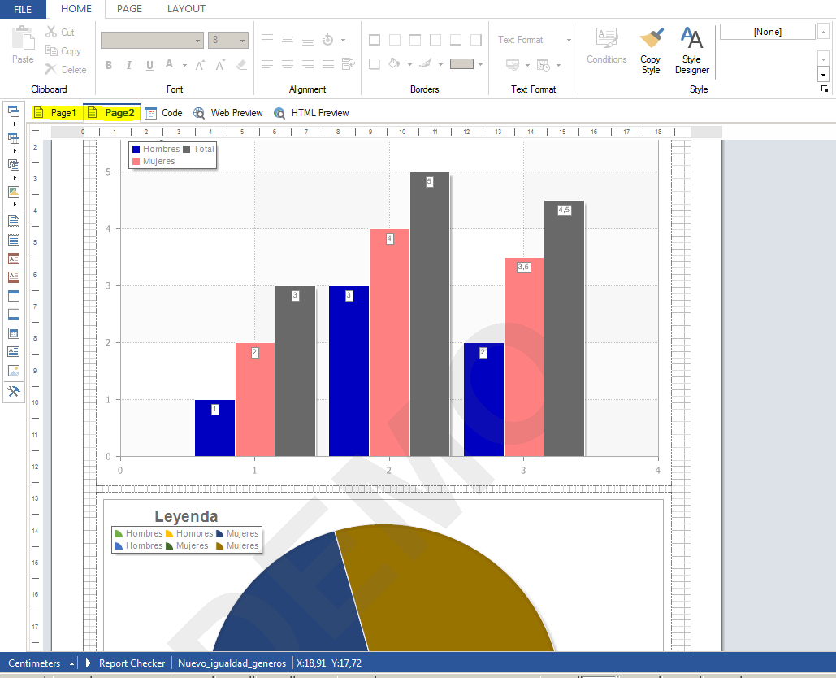
Original report created from “Desktop.exe” Design view

Slide 2
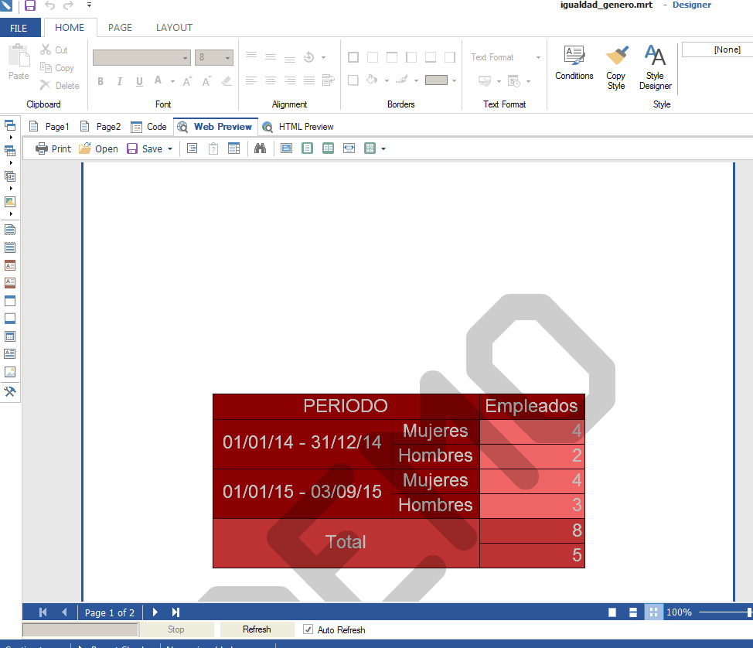
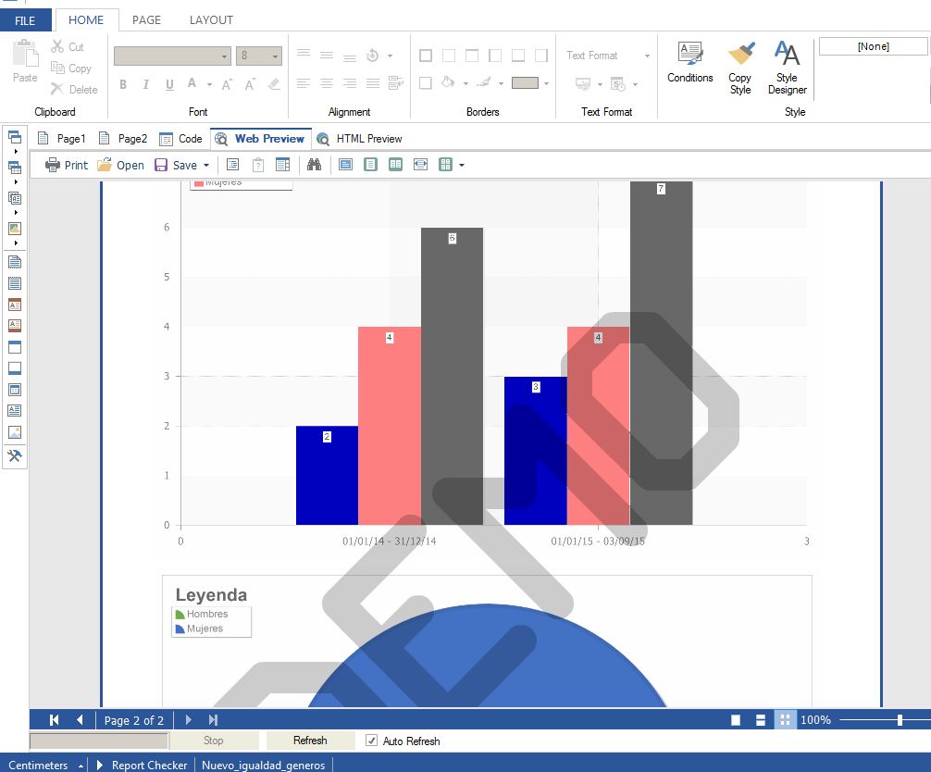
Original report created from “Desktop.exe” Preview

Slide 3
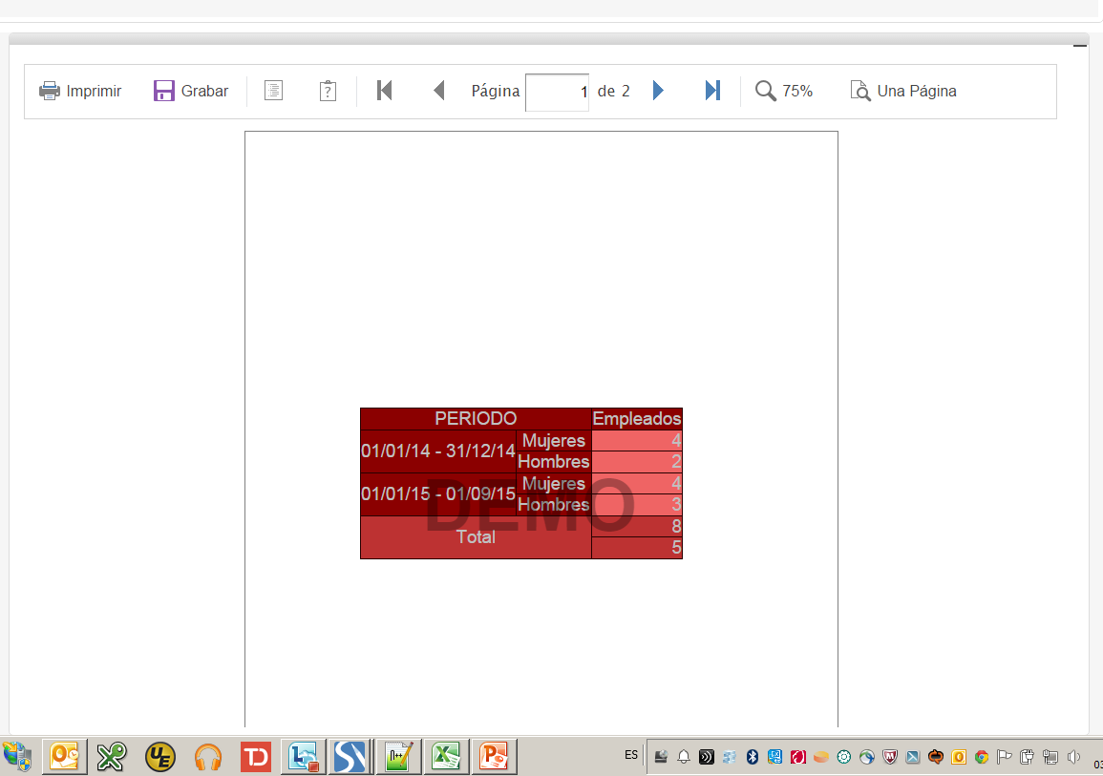
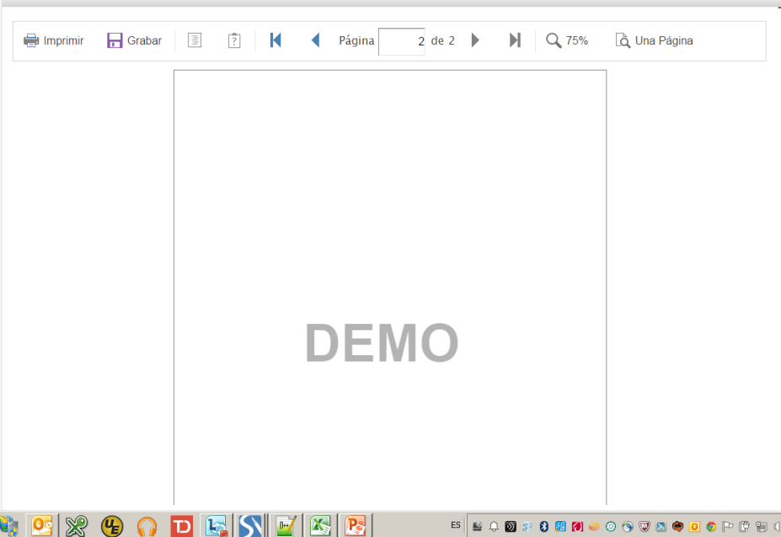
Original report created from “Desktop.exe” Preview on Mobile Designer

Slide 4
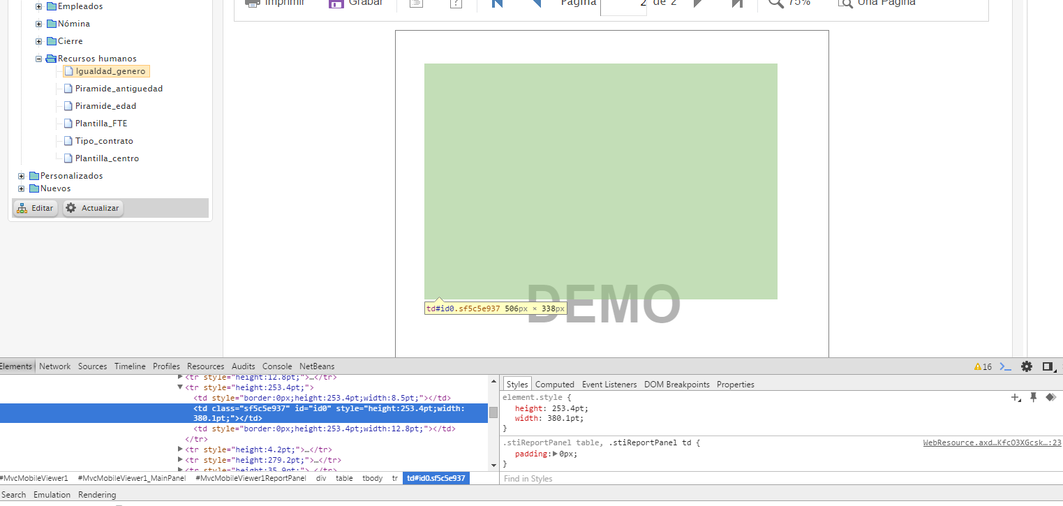
Original report created from “Desktop.exe” Debug on Mobile Designer

